Slide 1
501-01 : Advance Web Designing
TYBCA – SEM 5
SDJ International College
Prof. Nehal Patel
SDJ International College,
Vesu, Surat

Slide 2

MongoDB
MongoDB? NoSQL?
Advantages
Features
Database, Collections, Documents
CRUD Operations
Operators

Slide 3









Types Databases
1. RDBMS
Relational Database Management System
2. OLAP
Online Analytical Processing
3. NoSQL

Slide 4
MongoDB & NoSQL
"MongoDB is a scalable, open source, high performance, document-oriented database." - 10gen
MongoDB began in 2007
Developed as a PAAS (Platform as a Service). Later in 2009
Released in March 2010
MongoDB2.4.9 was the latest and stable version January 10, 2014.

Slide 5
Primary purpose of building MongoDB
Scalability
Performance
High Availability
Scaling from single server deployments to large, complex multi-site architectures.
Develop Faster
Deploy Easier
Scale Bigger

Slide 6
MongoDB Advantages
schema less
difference between number of fields
single object
no complex joins
deep query
easy to scale
fast access

Slide 7
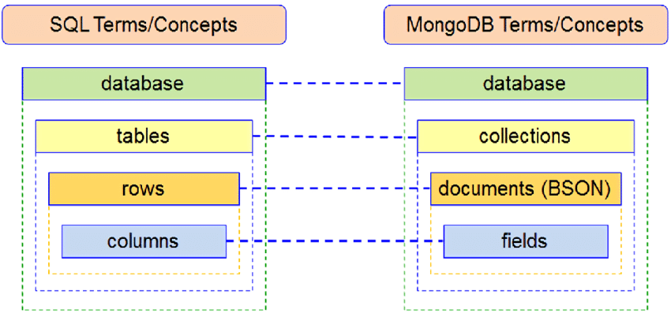
NOSQL

Slide 8
Data Types
Data Types | Description
String | String is the most commonly used datatype. It is used to store data. A string must be UTF 8 valid in mongodb.
Integer | Integer is used to store the numeric value. It can be 32 bit or 64 bit depending on the server you are using.
Boolean | This datatype is used to store boolean values. It just shows YES/NO values.
Double | Double datatype stores floating point values.
Min/Max Keys | This datatype compare a value against the lowest and highest bson elements.
Arrays | This datatype is used to store a list or multiple values into a single key.
Object | Object datatype is used for embedded documents.
Null | It is used to store null values.
Symbol | It is generally used for languages that use a specific type.
Date | This datatype stores the current date or time in unix time format. It makes you possible to specify your own date time by creating object of date and pass the value of date, month, year into it.

Slide 9
Database Commands
Create Database
Switch Database
List Database
Drop Database
Create Collection
Insert Document
Update Document
Delete Document
Find Document

